Slide 1

Authentication on mwater
This user guide will help you with the authentication process on the mWater Plateform

Slide 2
mWater
TABLE OF CONTENT: 1. FIRST STEP Page 3-5
2. SIGNUP PROCESS Page 6-10
3. LOGIN PROCESS Page 11-15
Platform compatibility: 1. Laptop web browser
II. Mobile mobile

Slide 3
First step
The connection link
The mWater front page

Slide 4
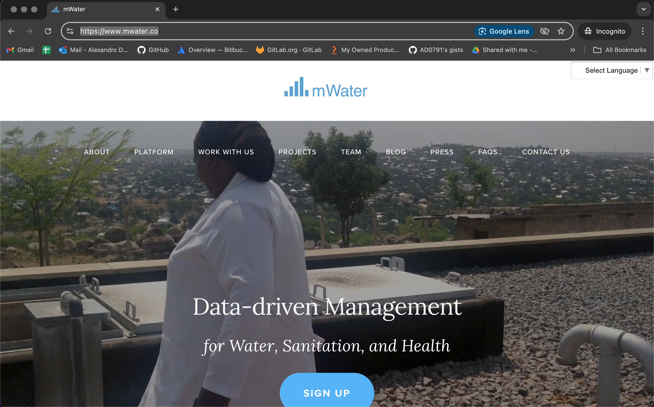
MWATER
CONNECTION LINK: https://www.mwater.co

Slide 5
main page
You can choose your language

Slide 6
SIGNUP
What are the steps?
Connection with the mWater plateform
The front page presentation
The signup form
The home page presentation

Slide 7
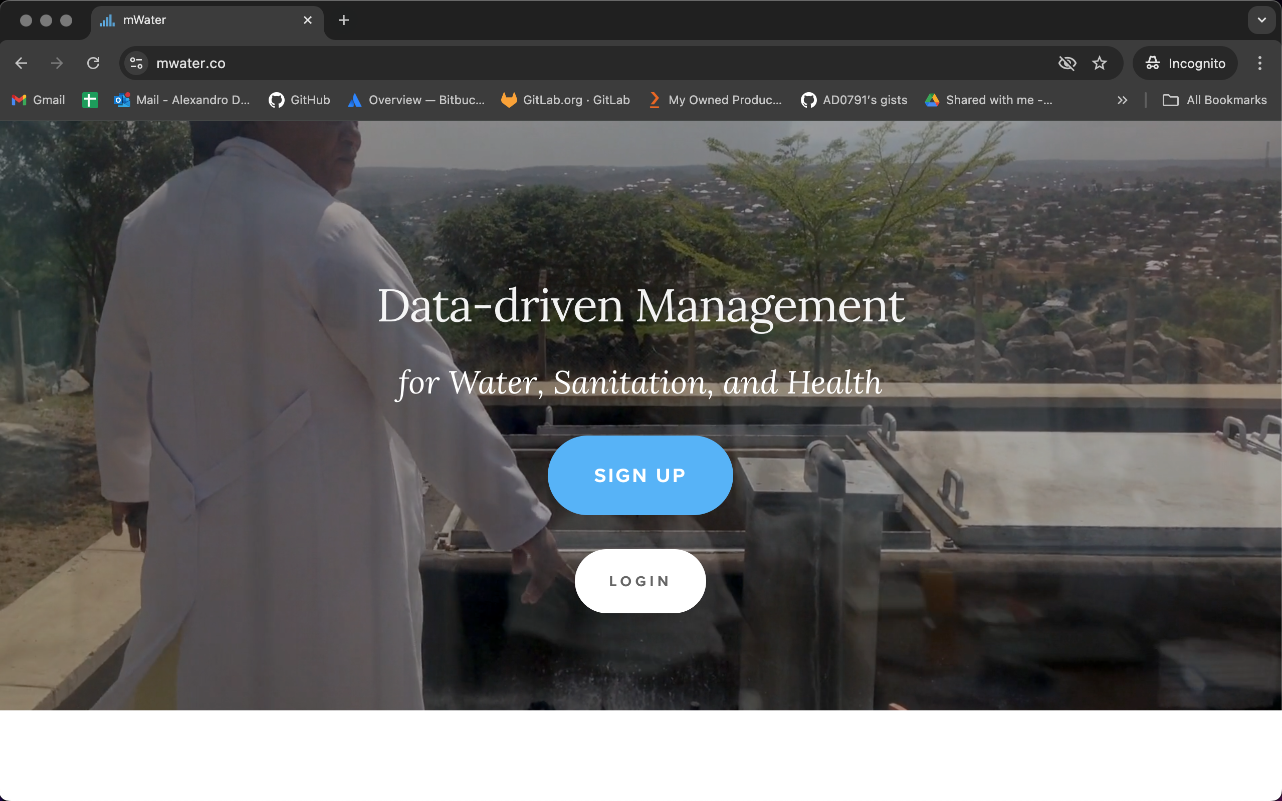
Main Page
Now please click to access the sign up page.

Slide 8
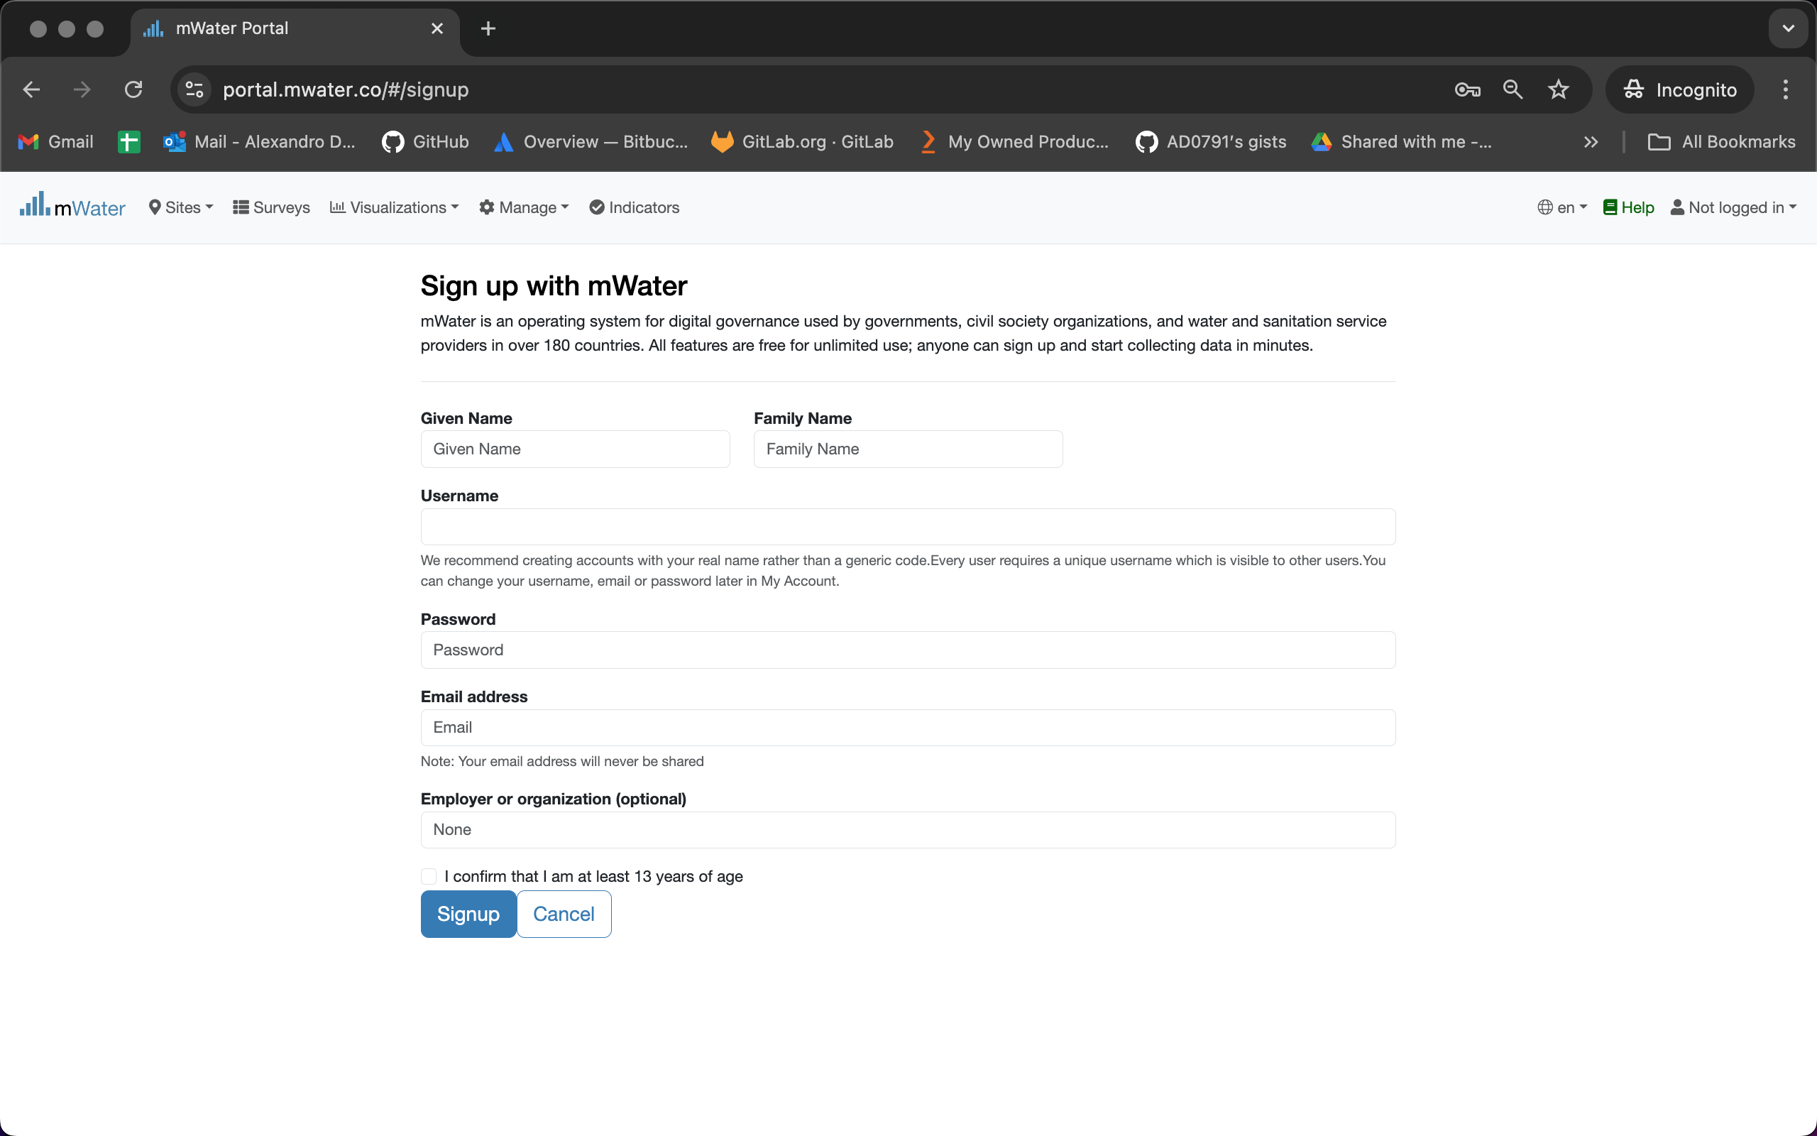
The signup page
This indicate that you are not logged in the system yet.
You can change the language here. Right now it indicates that this page is in english.
Fill, respectivelly, with you first name and last name.
The username should be: “first_name.last_name” like : alexandro.disla
Fill you password and a functional email address.
Organizaition is HANWASH. Click on the confirm button.
Click on the signup button when you are done.

Slide 9
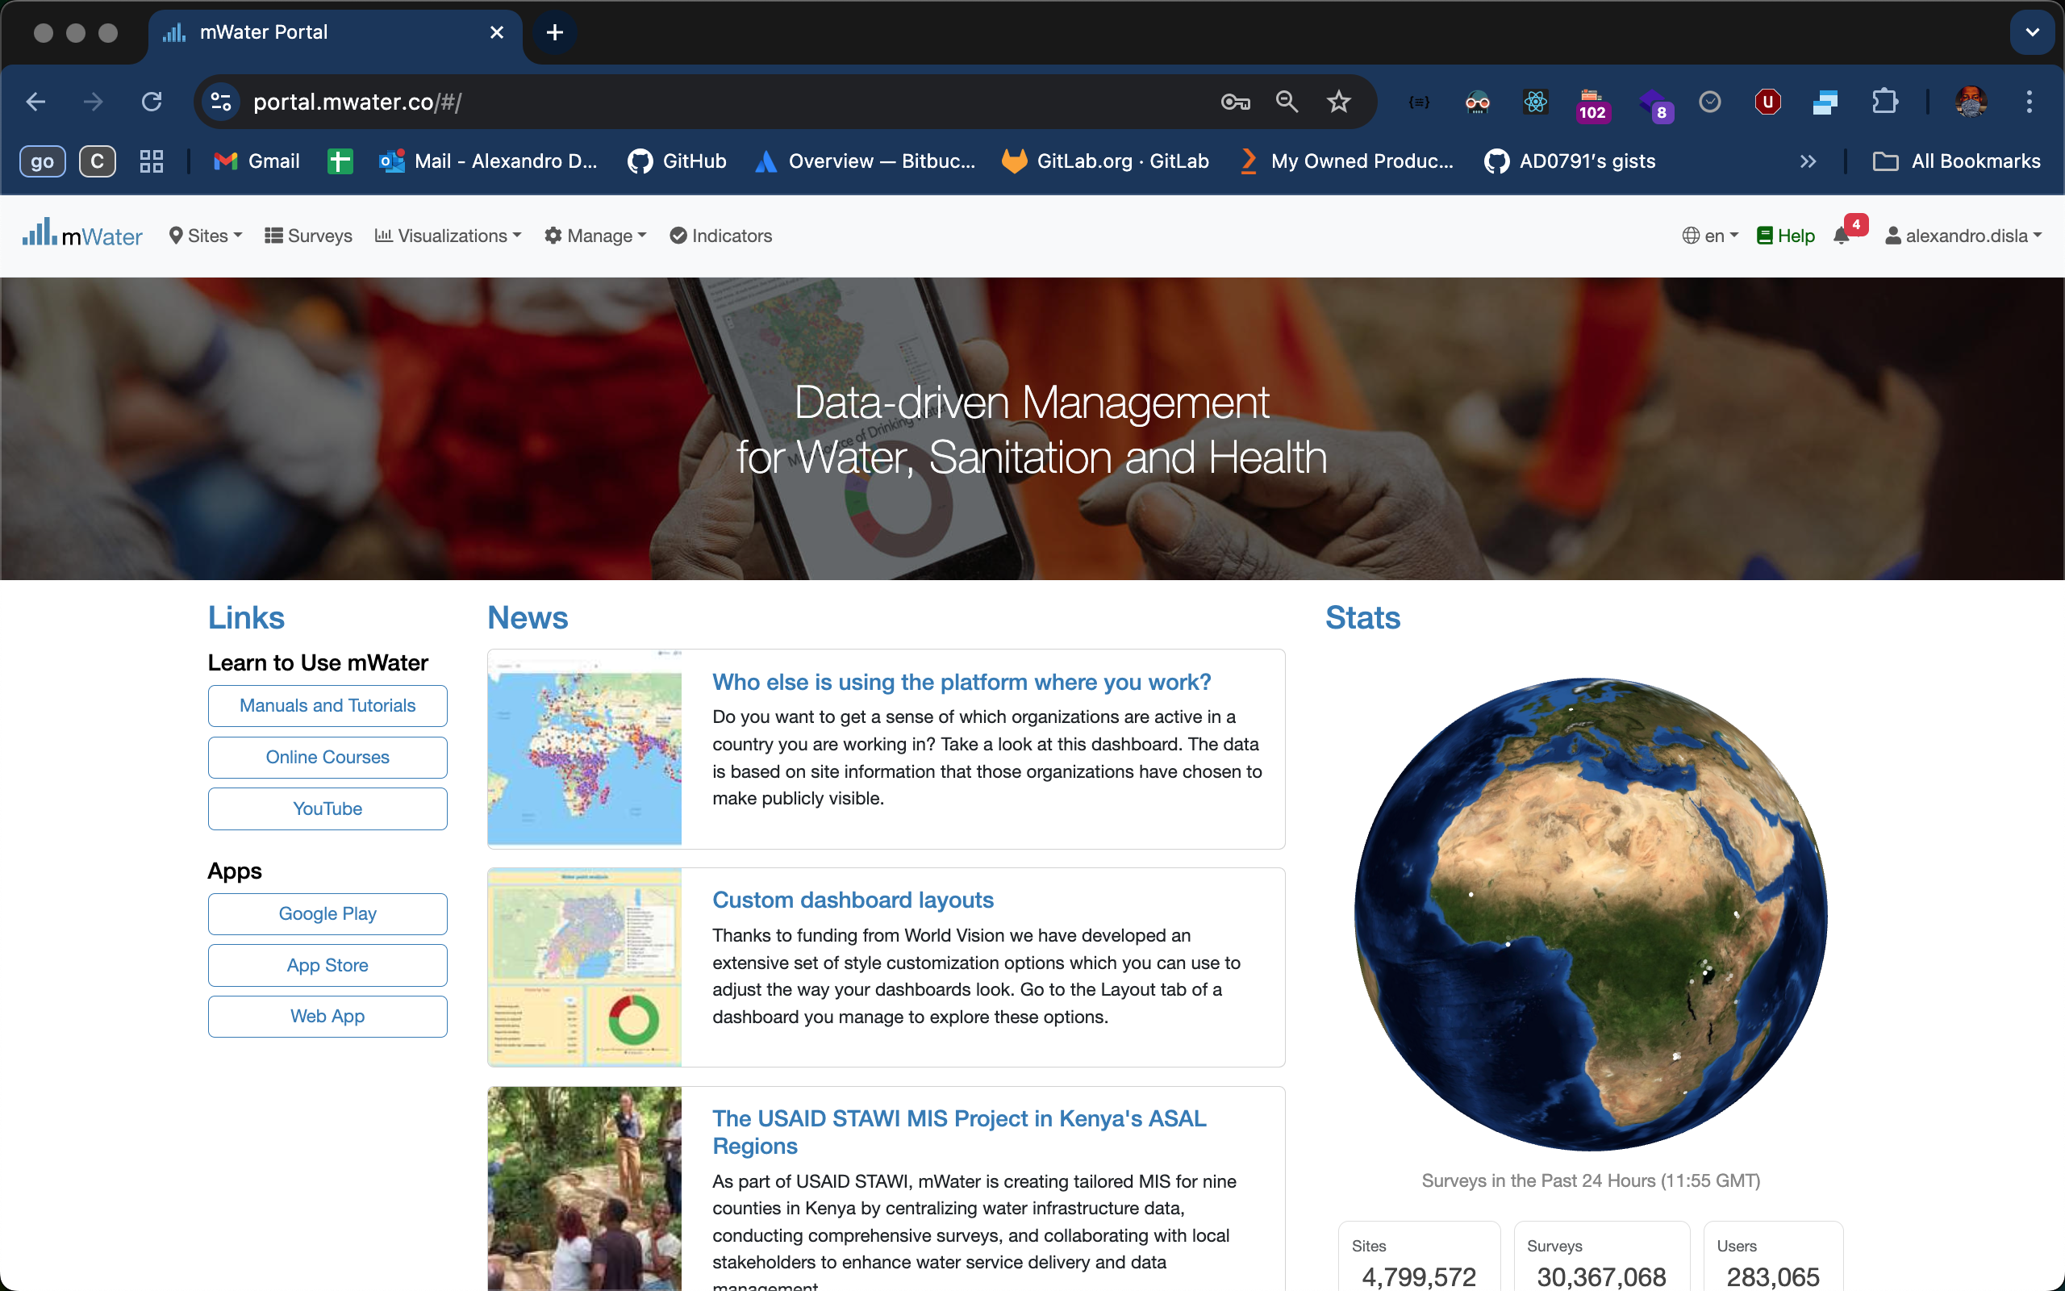
Mwater Homepage
This will indicate you username. The process is done and complete.

Slide 10
Thank You !!!
PLEASE FEEL FREE TO CONTACT ME BY :
Email / alexandro.disla@hanwash.org
Whatsap or Phone / +50941483700

Slide 11
Login
What are the steps?
Connection with the mWater plateform
Access the login page
Fill the login form
The mWater home page

Slide 12
Main Page
Click on the login button to access the login page.

Slide 13
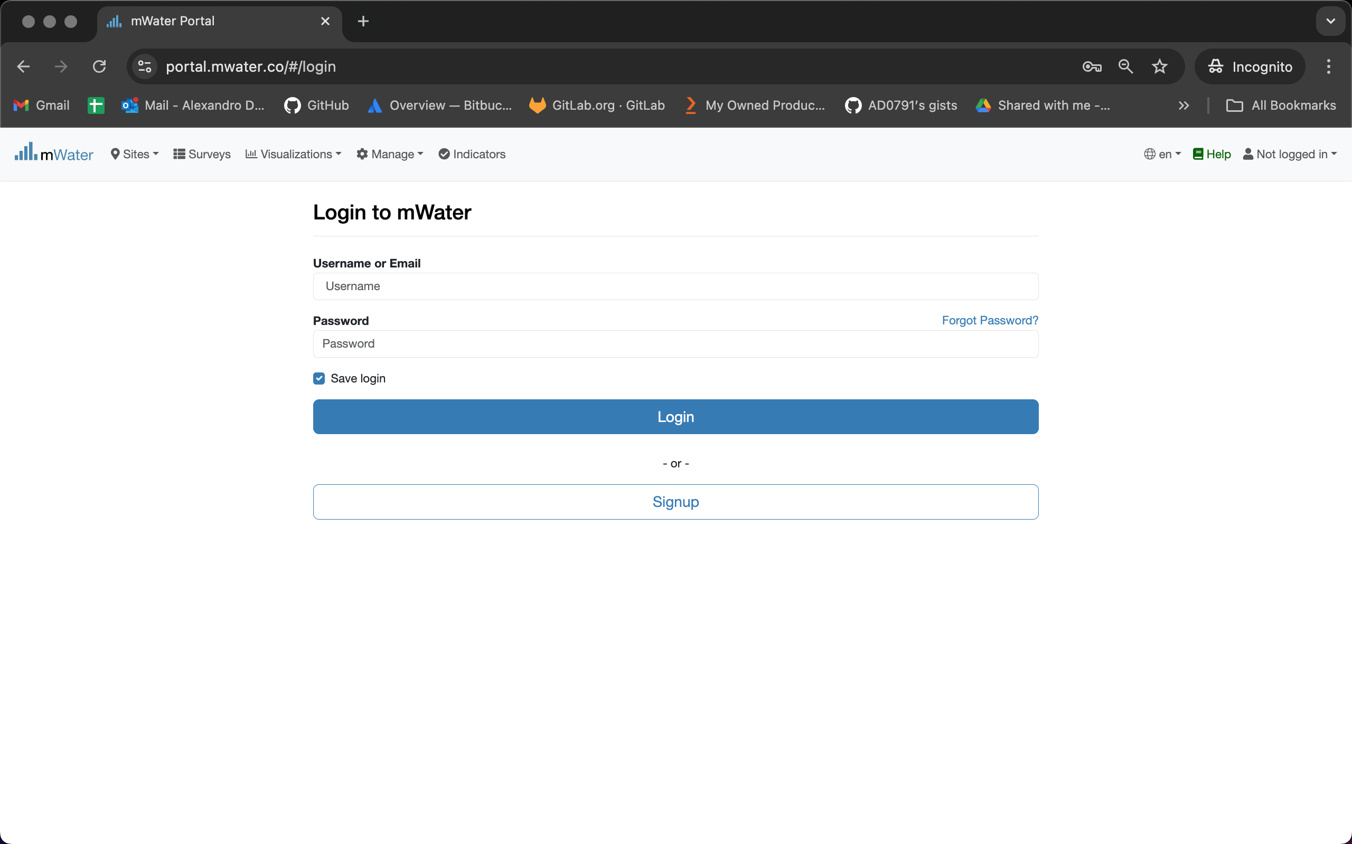
Login page
Fill your username or you email. Fill your password.
Click on the login button when you are done.

Slide 14
Mwater Homepage
This will show you username. The process is done and complete.

Slide 15
Thank You !!!
PLEASE FEEL FREE TO CONTACT ME BY :
Email / alexandro.disla@hanwash.org
Whatsap or Phone / +50941483700

